Slide 1
3.2 The Derivative Function
MATH 205

Slide 2
Derivative at a point versus the Derivative Function
But suppose, instead of looking at a single point, we wish to find a rule to determine the instantaneous rate of change anywhere on a given function.
If such a rule exists, we would have a function whose outputs would be the original functions IROCs for any input.
The derivative of a function f(x) with respect to the variable x is the function whose value at x is:
provided this limit exists.

Slide 3
A few more definitions
Differentiable at a point:
If exists at x = a, then f is differentiable at x = a.
Differentiable (function):
If exists for all x in the domain of f, then f is called differentiable.
The act of taking a derivative is differentiation.
The reverse is called Antidifferentiation.

Slide 4
Notation
There are many ways to write the derivative of a function:

Slide 5

Practice
$\frac{d}{dx}\left(x^{2}−3x+1\right)$

Slide 6

Practice
$y^{′}\left(x\right) for y=\frac{2}{x+5}$

Slide 7

Practice
$f^{′}\left(x\right)=\sqrt{3x+5}$

Slide 8

Practice
$f^{′}\left(0\right) for f\left(x\right)=\left|x\right|$

Slide 9
Where does differentiability fail?
Though a function may be continuous at a point, it might not be differentiable at the point.
Continuity DOES NOT guarantee differentiability.

Slide 10
Three behaviors that ruin differentiability
Corner:
Cusp:
Vertical Tangent:
Discontinuity:

Slide 11
So, what can we conclude?
Continuity at a point does not guarantee differentiability at that point!
If a function is differentiable at a point, then it is continuous at that point.
A differentiable function is a continuous function
In terms of functions defined on closed intervals, we can discuss right/left-handed differentiability just as we described right/left-handed continuity.

Slide 12
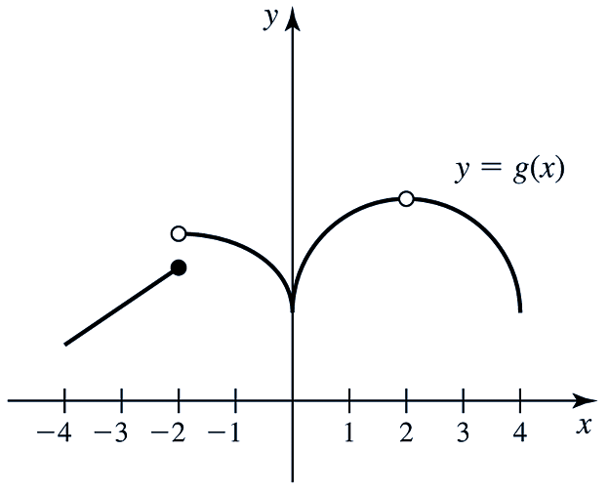
Graphically
Given the graph of g(x) on (-4, 4), determine where:
g(x) is not continuous
g(x) is not differentiable
graph $g^{′}(x)$
Derivative Plotter

